Slide 1


Computer Aided Reasoning
for Smart Contracts
Steven Stewart, CTO

Slide 2
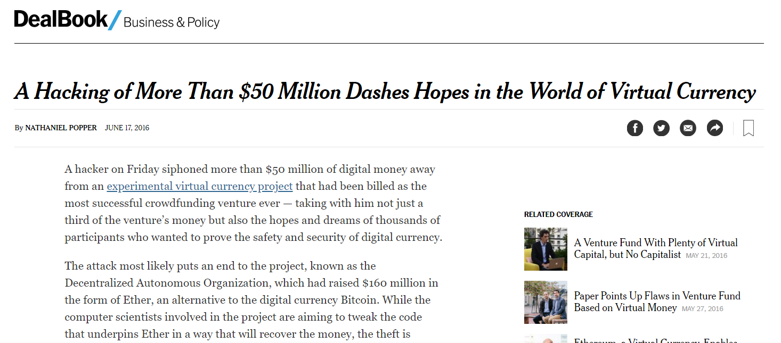
Motivation 2
Notes:
(Motivation - Smart Contracts Are Targets)
The D.A.O. (Decentralized Autonomous Organization) project was hacked on or about 18th June 2017. The attacker drained more than 3.6m ether into a separate contract. The price of Ether dropped from $20 to $13; the amount stole was more than $50m at the time of the attack.
Smart contracts hold millions of dollars of assets and are high-value targets.

Slide 3

Notes:
(Motivation - New Exploits Common)
Smart contract exploits are not a thing of the past. This is a recent (22-24 April 2018), and no significant loss of assets, there are effects on the markets and the confidence of the platform. This attack attempted to create tokens, e.g. 1x10^60 Beauty coin, each of which was worth $0.32. Values of several coins dropped during the attack.

Slide 4
Level | Cause of vulnerability
Solidity | Call to the unknown Gasless send Exception disorders Type casts Reentrancy Keeping secrets
EVM | Immutable bugs Ether lost in transfer Stack size limit
Blockchain | Unpredictable state Generating randomness Time constraints
“A survey of attacks of Ethereum smart contracts”
Atezi & et al., 2017
Notes:
(Smart Contracts Have New Vulnerabilities)
Talk about the specific attacks for smart contracts. This is a summary of attacks considered in the paper “A survey of attacks of Ethereum smart contracts” published year. The paper describes attacks for all but three of these (type casts, ether lost in transfer, generating randomness). Note that smart contracts are vulnerable through multiple aspects of the blockchain environment.

Slide 5



Computer Aided Reasoning
Code
Reasoning Engine
Result
Active area of research & development
Automatic, efficient, exhaustive checks
Notes:
(Computer-Aided Reasoning Introduction)
Describe the solution: the use of efficient, automated, tools for exhaustive checking of software code. Note that there are several ways of doing this: symbolic execution, model checking, and others (e.g. abstract interpretation). Note that these methods generalize testing and are more effective: they test multiple/all inputs, and they often provide proof that a specific property will not be violated.
Note that in both academia and the industry, these techniques are constantly being improved. Several techniques are the results of years of research and will continue to do so as the tools are often more general (e.g., SAT solver).

Slide 6



Success Stories
Notes:
Talk about how these companies successfully used these technologies to do program verification.
Microsoft: development of Z3 (Microsoft Research); use of SLAM to check C code automatically - was successfully applied to find errors in the Windows kernel (specifically targeting device drivers).
NASA: formal methods in use for safety-critical software. Development of Java Pathfinder (model checker with symbolic execution plug-in). Java Pathfinder applied to several in house projects; adapted for use for checking Android application source.
Facebook: static analysis used to verify Facebook’s modifications to it’s mobile apps (both Android and iOS): main app, messenger, Instagram. Uses INFER static analysis.

Slide 7
Two Examples
function withdraw() {
if (balances[msg.sender] > 0
&& bankBalance > 0){
msg.sender.call.value(balances[msg.sender])
bankBalance -= balances[msg.sender];
balances[msg.sender] = 0;
}
}
function transferBalance(address dest) {
// no need to update bankBalance: money does not leave the bank
if (balances[msg.sender] > 0
&& member[msg.sender] && member[dest]) {
balances[dest] += balances[msg.sender];
balances[msg.sender] = 0;
}
}
Notes:
(Running Example)
Two interesting Solidity functions in a simple bank example; the full contract is at the end of the presentation for reference.

Slide 8


Symbolic Execution
Code
Notes:
(Symbolic Execution - Introduction)
First approach: symbolic execution (introduction to the method).
King [Comm. ACM 1976]
• Analysis of programs with unspecified inputs
– Execute a program on symbolic inputs
• Symbolic states represent sets of concrete states
• For each path, build a path condition
– Condition on inputs
– for the execution to follow that path
– Check path condition satisfiability
– explore only feasible paths
• Symbolic state
– Symbolic values/expressions for variables
– Path condition
– Program counter
Execution paths that are not problematic marked with green stamps; paths are problematic are marked with a warning triangle; paths that are unreachable have a “no” sign

Slide 9
Symbolic Execution
𝞪 (10)
function transferBalance(address dest) {
// no need to update bankBalance: money does not leave the bank
if (balances[msg.sender] > 0
&& member[msg.sender] && member[dest]) {
balances[dest] += balances[msg.sender];
balances[msg.sender] = 0;
}
}
false
true
𝞫 (11)
𝞪
𝞬
𝞬 (11)
𝞫
(12)
(13)
Notes:
In this example, the use of symbolic execution doesn’t find any errors. (Shaded blocks of code correspond to branching in the tree)
States that are not problematic are stamped in green; problematic states are marked with a warning triangle.
No reentrancy. No division by zero.

Slide 10
Reachability
Satisfying
Assignment
y < 5
x₁
⋀
SAT
Solver
!(x < z) && z == 2
(x₂ ⋀ x₃)
⋀
Unsatisfiability
Proof
y >= 5
¬x₁
Notes:
TODO: change the example here so that it comes from the example code?

Slide 11
SMT
Theory
Solver
Satisfying
Assignment
y < 5
x₁
Theory
Queries
Unsat
Reason
⋀
SAT
Solver
x <= 6 && z == 2
(x₂ ⋀ x₃)
⋀
Unsatisfiability
Proof
y >= 5
¬x₁
Notes:
TODO: change the example here so that it comes from the example code?

Slide 12
Symbolic Execution II
𝞭 (2)
𝞭
false
true
function withdraw() {
if (balances[msg.sender] > 0
&& bankBalance > 0){
msg.sender.call.value(balances[msg.sender])
bankBalance -= balances[msg.sender];
balances[msg.sender] = 0;
}
}
𝛆 (3)
𝛆
(4)
𝞭 , 𝛆
still true
(5) (6)
Notes:
For this function, symbolic execution successfully identifies a re-entrancy vulnerability in the line immediately following the if-statement.
States that are not problematic are stamped in green; problematic states are marked with a warning triangle.
Symbolic execution will only check sequential executions, non-concurrent. We don’t have any information on the contract being called.
Pitfall: this might not actually be an issue if you know the contract being called.
Note that line (4) does not *always* produce a warning. The symbolic execution engine will check to see if the path condition (𝞭) up to the state (3) still holds after executing line (3) - if it does, there is a reentrancy concern. If not, the call is not vulnerable. Thus, it does more than simply finding all instances of the ‘call’ function.

Slide 13
Reentrancy
msg.sender.call.value(balances[msg.sender])
bankBalance -= balances[msg.sender];
balances[msg.sender] = 0;
B
A
A
A
A
A
Call
withdraw
withdraw
withdraw
deposit
fallback
fallback
fallback
Ether
B
B
B
B
Time
Notes:
A description of the re-entrancy issue that could cause concerns as in the last example.
TODO: animations?

Slide 14
Model Checking
Code
Specification
Notes:
Intro to model checking
• Model individual state machines for subsystems / features
• Model Checking:
– Automatically combines behavior of state machines
– Exhaustively explores all executions in a systematic way
– Handles millions of combinations
– hard to perform by humans
– Reports errors as traces and simulates them on system models
States that satisfy the invariant are marked with green stamps; states that do not are marked with a warning triangle; states that are unreachable have a “no” sign

Slide 15
Our Invariant
// Invariant (I): bankBalance = sum(balances)
function withdraw() {
if (balances[msg.sender] > 0
&& bankBalance > 0){
msg.sender.call.value(balances[msg.sender])
bankBalance -= balances[msg.sender];
balances[msg.sender] = 0;
}
}
function transferBalance(address dest) {
// no need to update bankBalance: money does not leave the bank
if (balances[msg.sender] > 0
&&member[msg.sender] && member[dest]) {
balances[dest] += balances[msg.sender];
balances[msg.sender] = 0;
}
}
Notes:
Present the invariant (necessary for model checking). Code is the same as before.

Slide 16
Our Invariant
// Invariant (I): bankBalance = sum(balances)
function transferBalance(address dest) {
// no need to update bankBalance: money does not leave the bank
if (balances[msg.sender] > 0
&& member[msg.sender] && member[dest]) {
balances[dest] += balances[msg.sender];
balances[msg.sender] = 0;
}
}
S_{i}
S₀
transferBalance(Richard)
transferBalance(Steven)
S_{i+1}
S'_{i+1}
Notes:
The use of model checking can find additional errors. In this case, the previous “good” function transferBalance doesn’t meet the specification.
States that satisfy the invariant are marked with green stamps; states that do not are marked with a warning triangle.
Many implementations translate the (bounded) model to a SAT formula and check that instead of the model itself.

Slide 17
Challenges
State Space Explosion
State Size
Computing Reachability
Notes:
Challenges to these approaches: state space explosion (large left arrow), reachability computations (right box), individual state size (four-way arrow)
State space explosion can reduce the ability to check properties in each state, and increase the complexity of determining reachability.
In both symbolic execution and model-checking, reachability is key. You can use this slide to discuss how reachability is checked (e.g., through the use of SAT solvers, discussed previously). Previous examples serve to illustrate that this is a common goal.
Note that if you’re doing explicit state model checking, the size of those states is also a challenge if it’s large. Finding an abstraction is helpful: this is “symbolic model checking”, the combination of the two techniques discussed in this talk.

Slide 18

Comparison
Symbolic Execution
Model Checking
Exhaustive*
Concurrency
Plug and play
Notes:
Use this slide to discuss trade-offs between the two techniques.
Most people use these techniques in tandem.
Exhaustive is marked with a * in order to indicate that in some cases, bounds on the execution path/model may be used (e.g., in bounded model checking).
Concurrency cannot be easily checked with symbolic execution because it doesn’t take into account things like v

Slide 19
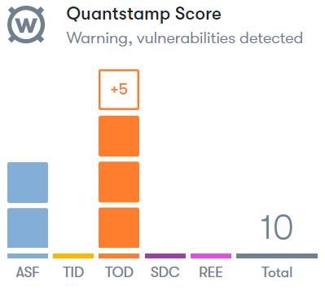
Conclusion
Efficient, relevant
checks
Easy to use
Notes:
Summary. Promotion of web-tool?

Slide 20
Thank you!
Questions?
Notes:
Thank the audience; ask for questions; promote Quantstamp?

Slide 21
Full Example
function withdraw() {
if (balances[msg.sender] > 0
&& bankBalance > 0) {
msg.sender.call.value(balances[msg.sender])
bankBalance -= balances[msg.sender];
balances[msg.sender] = 0;
}
}
function transferBalance(address dest) {
// no need to update bankBalance: money does not leave the bank
if (balances[msg.sender] > 0
&& member[msg.sender] && member[dest]) {
balances[dest] += balances[msg.sender];
balances[msg.sender] = 0;
}
}
}
// Invariant (I): bankBalance = sum(balances)
contract Bank {
mapping (address => uint) balances;
mapping (address => bool) members;
uint bankBalance;
function join() {
members[msg.sender] = true;
}
function deposit() {
balances[msg.sender] += msg.value;
bankBalance += msg.value;
}
Notes:
Not intended to be presented unless necessary

